Slide 1
Lets Try An Example
Author: Hoyden L’Heureux

Slide 2
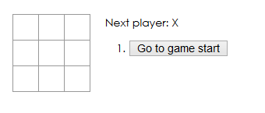
Here’s what we are building:
A simple Tic Tac Toe game

Slide 3
To Begin:
Grab the starter files from GitHub with the following link:
bit.ly/HLH-EX01

Slide 4
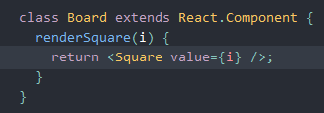
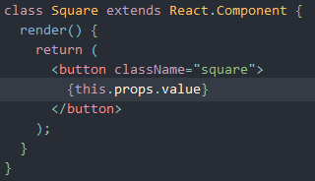
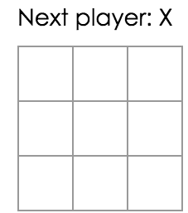
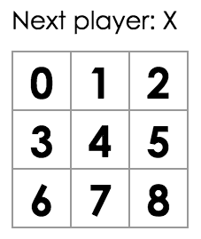
Step 1:
Checking that each square has its own unique identification
To do this we will modify the Board class and the Square class

Slide 5
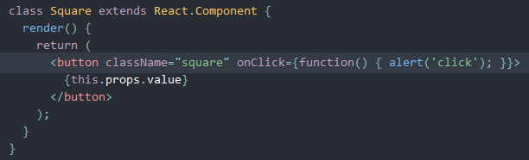
Step 2 – Adding Interactivity
We want to make sure an ‘X’ is added when we click the box
Let’s test it with getting an alert when we click on a square

Slide 6
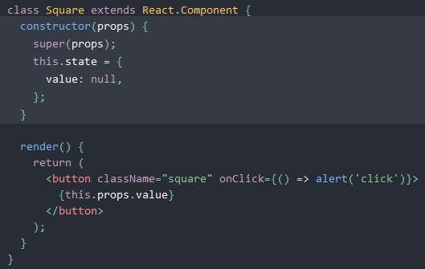
However, it’s not perfect
Since we want to make sure the square ‘remembers’ that it was clicked,
we need to add a constructor to the Square class.

Slide 7
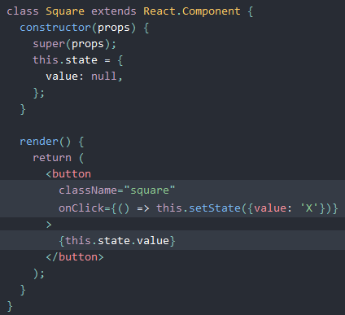
And we need to change render()
This way the square will display the current states value when clicked

Slide 8
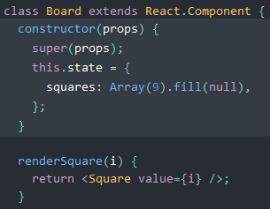
Step 3 – Starting the board as nulls
We need to have the game board start as nulls
Therefore we need to change the Board class

Slide 9
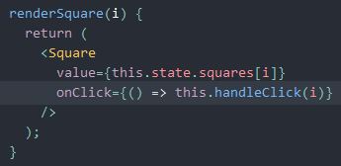
Step 4 – Actually changing with clicks
Now we need to change the square when the user clicks on it
Since Board’s state is considered private, we can not change it with the Square class

Slide 10
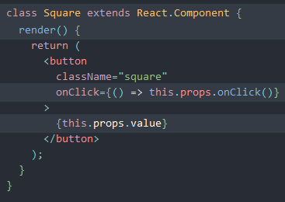
And we need to modify Square
Since we are passing two props, we have a few changes to make

Slide 11
What happens when you try it out?
If you are not getting an error then lets check each others code
If you are getting an error – don’t panic its supposed to be there.

Slide 12
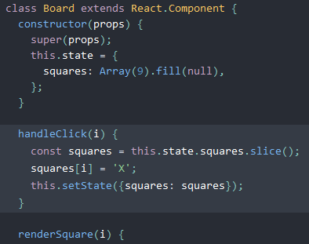
Yes, we need handleClick()
Otherwise Board does not know what to do and React just gives an error (scary!)

Slide 13
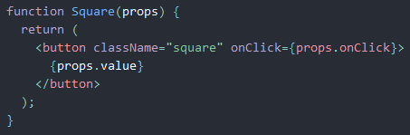
Square - becomes a function component:
This will help to make the component and rendering less tedious and faster in the app

Slide 14
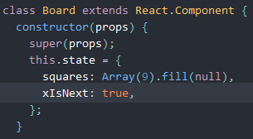
Step 5 – Taking Turns
Well, we can’t always have Player ‘X’ can we?
So we need to make a few changes
First to Board

Slide 15
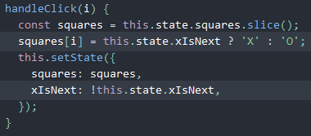
And then handleClick()
We need to flip a Boolean so we know which player is next

Slide 16
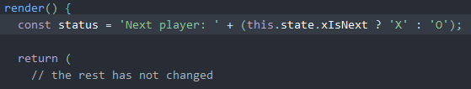
And then render()
This is to ensure it shows which player is next in our text prompt

Slide 17
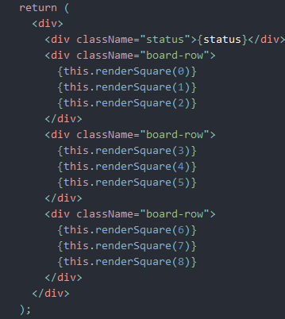
In case you missed it:

Slide 18
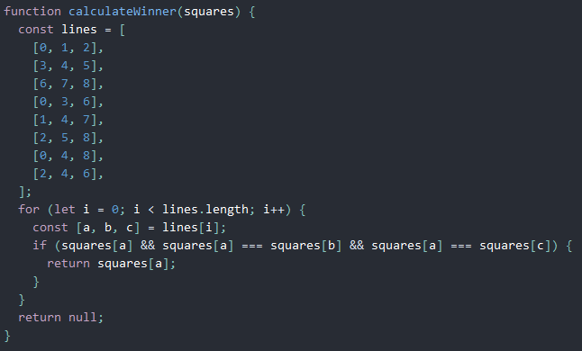
Step 6 – Finding a winner
Lets start with creating a function called calculateWinner which accepts a parameter of squares
Which allows to check an array of 9 squares to find if ‘X’, ‘O’ or null is the current winner

Slide 19
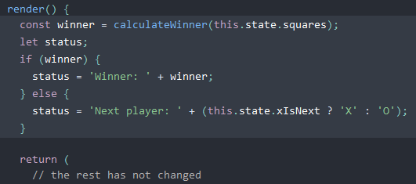
Change Boad to call calculateWinner()
We now have to add the call for calculateWinner to find a winner in our Board class

Slide 20
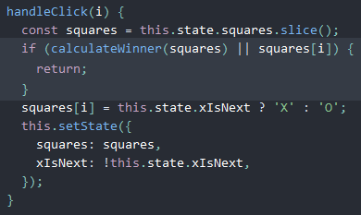
And to stop playing …
We of course want to stop playing when we have a winner,
So we need to change handleClick()

Slide 21
And that’s Tic-Tac-Toe!
Want a challenges:
Add in `Time Tràvel`with seeing the moves after the game has completed
Clearing the page and showing a refreshed page
Storing names
Adding in Win/Losses/Draw for the games played

